Slide 1
WELCOME
Class: B.Com – Part-2
Subject: Business Regulatory Framework
TOPIC: Agreement – Meaning, Types and Differences between Agreement and contract
Prepared By
Dr. SHAHID IQBAL
Guest Faculty,
Marwari College, Darbhanga,
Mobile No. and Whatsup No. : 7004160257
Email ID: shahidlnmu@gmail.com

Slide 2
Agreement : -
The Indian Contract Act, 1872 defines what we mean by “Agreement”. In its section 2 (e), the Act defines the term agreement as “every promise and every set of promises, forming the consideration for each other”.
There must be an agreement between the parties of a contract. It involves a valid offer by one party and a valid acceptance by the other party. Agreement is created by offer and acceptance. Therefore an agreement is = offer +acceptance. It is only by an agreement a contractual relation is established between the parties. For example, A sends a proposal to B to purchase a property for Rs. 10 lakhs and B accept the same, then this result into an agreement.

Slide 3
Types of Agreement : -
The following are the types of agreement are as under:
Wagering Agreement: Agreements entered into between parties under the condition that money is payable by the first party to the second party on the happening of a future uncertain event, and the second party to the first party when the event does not happen, are called Wagering Agreements or Wager. There should be mutual chance of profit and loss in a wagering agreement. Generally wagering agreements are void.

Slide 4
2. Void Agreement: “An agreement not enforceable by law is said to be void”. A void agreement has no legal significance from the beginning. No contract comes out from a void agreement i.e it is void ab initio. The following agreements are examples of void agreements:-
a) Agreement with persons like minors (sec.11)
b) Agreement made without consideration (sec.25)
c) Uncertain agreement (sec.29)
d) Impossible agreements (sec.56) etc.
3. Illegal Agreement: An agreement which is either prohibited by law or otherwise against the policy of law is an Illegal agreement. All illegal agreements are null and void but void agreements are not illegal. All collateral transaction to an illegal agreement are also illegal.

Slide 5
4. Voidable Agreement: A voidable contract is a formal agreement between two parties that may be rendered unenforceable for a number of legal reasons. Reasons that can make a contract voidable include the following:
  Failure by one or both parties to disclose a material fact
  A mistake, misrepresentation or fraud
  Undue influence or duress
  One party's legal incapacity to enter a contract
  One or more terms that are unconscionable
  A breach of contract
5. Express Agreement: A written or verbal contract allowing parties to declare their intentions and contract terms in speech.

Slide 6
6. Implied Agreement: An implied contract is a legally-binding obligation that derives from actions, conduct, or circumstances of one or more parties in an agreement. It has the same legal force as an express contract, which is a contract that is voluntarily entered into and agreed on verbally or in writing by two or more parties. The implied contract, on the other hand, is assumed to exist, but no written or verbal confirmation is necessary.
7. Conditional Agreement: A conditional agreement, also called a hypothetical agreement, is a agreement that only requires performance once the delineated conditions are met.

Slide 7
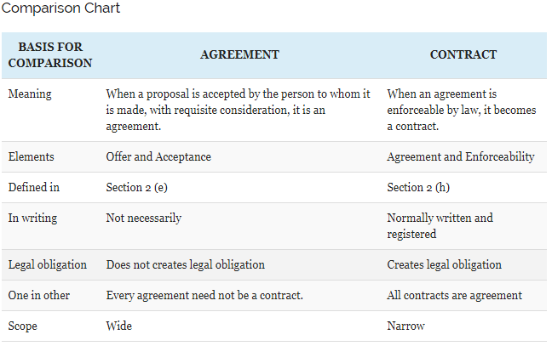
Differences Between Agreement and Contract

Slide 8
Key Differences Between Agreement and Contract:
The points given below are substantial so far as the difference between agreement and contract is concerned:
1. Promises and commitments forming consideration for the parties to the same consent is known as an agreement. The agreement, which is legally enforceable is known as a contract.
2. The agreement is defined in section 2 (e) while a Contract is defined in section 2 (h) of the Indian Contract Act, 1872.
3. The major elements of an agreement is the offer and its acceptance by the same person to whom it is made, for adequate consideration. Conversely, the major elements of an agreement are agreement and its enforceability by law.

Slide 9
4. Every agreement is not a contract, but every contract is an agreement.
5. An agreement needs not to be given in writing, but the contracts are normally written and registered.
6. The agreement does not legally bound any party for the performance. In the Contract, the people are legally bound to perform their part.
7. The scope of the agreement is wider than a contract because it covers all types of agreement as well as contract. On the contrary, the scope of a contract is relatively narrower than an agreement because it covers only that agreement which have legal enforceability.
It can also be defined as the contract which lacks enforceability by law is known as the agreement.

Slide 10
Thank You

